Slide 1
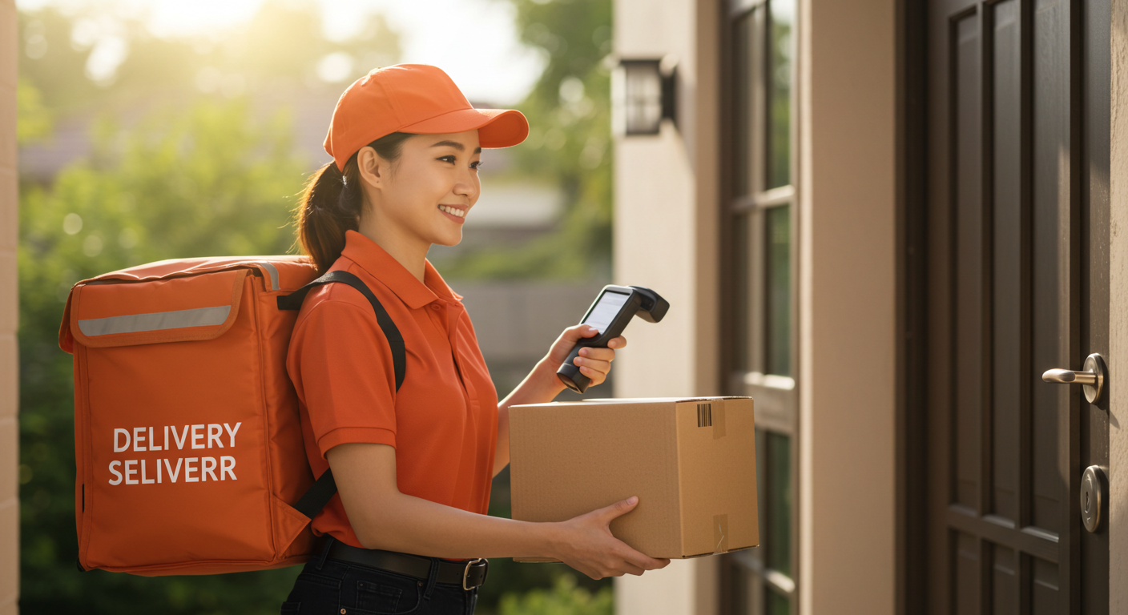
Smart Door Delivery Authentication System
Team Members:
Banuka Abeysundera
Gihan Atupolage
Umair Mohammeth
Senuri Minhari
Date 23.04.2025

Slide 2

What is smart door delivery authentication system (SDDAS)
This project addresses the rapid growth of online shopping, leading to risks such as parcel theft and mis-delivery.
Traditional CCTV systems are passive and lack real-time alerts.
This project introduces an IoT-based smart parcel box with authentication and tamper detection.

Slide 3
Background & Problem Statement
Unattended packages are easy targets for thieves
No identity verification during pickup.
No cyber-verifiable proof of delivery/pickup
Owners may not always be home to collect parcels
Traditional CCTV is passive, lacks smart detection

Slide 4



Proposed Solution
A smart parcel box with:
Offline SD logging for reliability
RFID-based access control
Load cell-based parcel detection
Dual camera monitoring
automatically locking after parcel placement
Telegram bot for real-time alerts with images

Slide 5

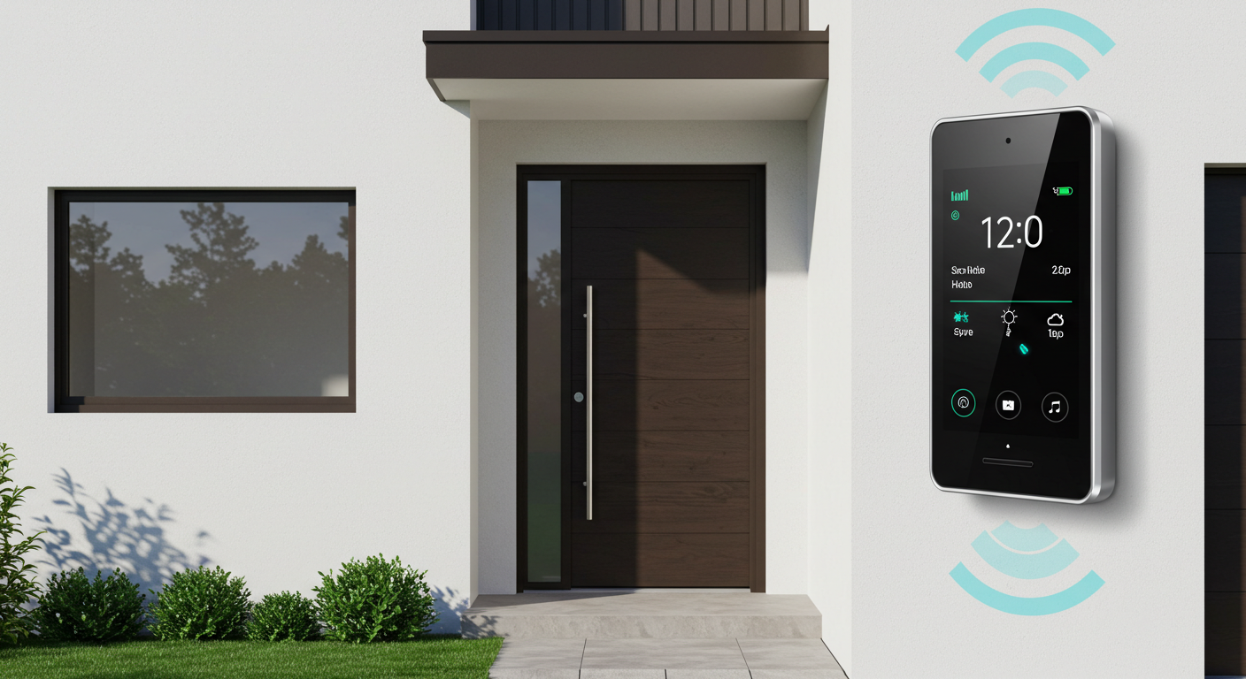
Existing Systems: What's Missing?
CCTV camera
✔ 24/7 Monitoring
✖ No real-time tamper alerts
✖ No secure package storage
Smart Doorbells
✔ Remote access & two-way audio
✖ No secure delivery box
✖ Weak tamper detection
The Gap​
Surveillance ≠ Security
Monitoring isn’t enough.
No active prevention/detection or safe package storage

Slide 6

Project Aim and Objectives
Aim
Build an IoT system to detect, authenticate and report parcel delivery and pickup events securely
Objectives
Research current technologies and systems, collect needed hardware and software
Build core features by setting up hardware and software.
Integrate hardware with software, test the system, and fix any issues.
Finalize the project by documenting the development process and designing the system.

Slide 7

Methodology – incremental model
Why Incremental model?
Modular Development: Each system module can be (e.g., RFID, camera, sensors) developed and tested independently.
Faster Delivery: Core functions implemented early.
Flexibility: Easy to add features (e.g., facial recognition) later.
Why Not Other Models?
Waterfall: Not flexible. Changes disrupt the sequence.
Agile: Overhead not necessary for a small project.
Spiral: Too complex for this low-budget project.

Slide 8
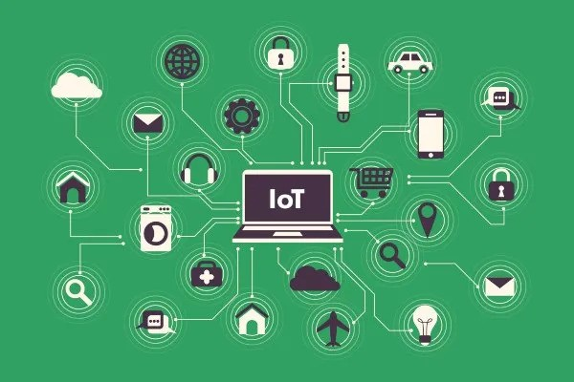
Technologies and tools Used
Component | Technology | Feature
Micro-Controller | ESP32-CAM | Wi-Fi + camera in one unit
Authentication | RFID RC522 | Secure user authentication
Programming Language | Arduino C / C++ | Lightweight and hardware compatible
Alerting | Telegram Bot API | Real-time, secure messaging
Detection | Load Cell + IR | Detect delivery/pickup/theft
Lock | Servo/Solenoid | Physical access control
storage | SD Card Module | Offline logs and images
Communication | Wi-Fi | Facilitate alerting system

Slide 9
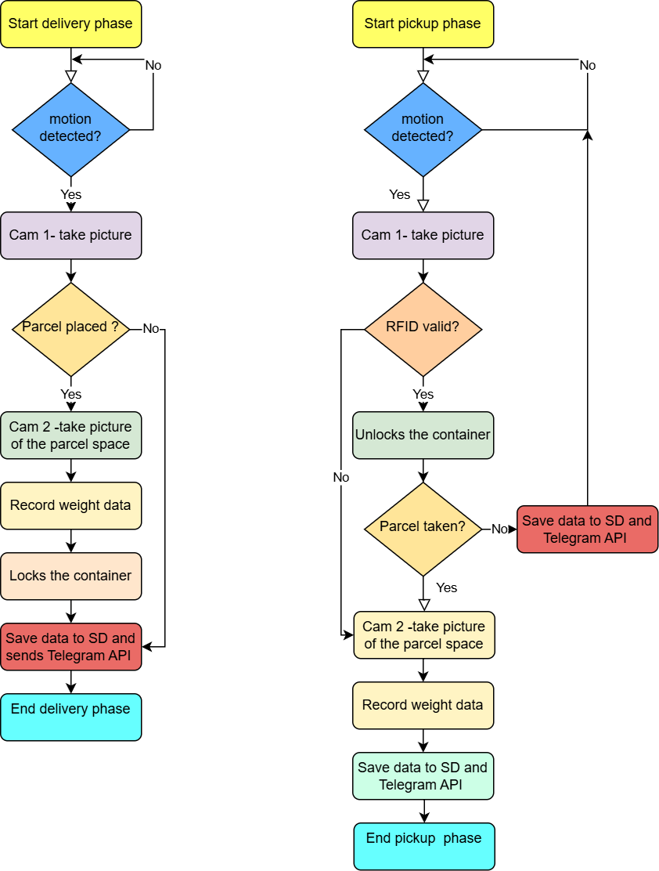
System Workflow design
Delivery Phase
Pickup Phase

Slide 10
Limitations and Risks
Supports only one parcel at a time
RFID may be vulnerable if duplicated
Depends on stable Wi-Fi for Telegram alerts
Hardware limits: low-light camera quality

Slide 11
Contingency Plan
Future versions may add two factor authentication (eg: OTP ) for RFID duplication protection.
Data is saved on the SD card for offline access, minimizing Wi-Fi dependency for alerts.
The design can scale with multiple compartments later, addressing the one-parcel limitation.

Slide 12
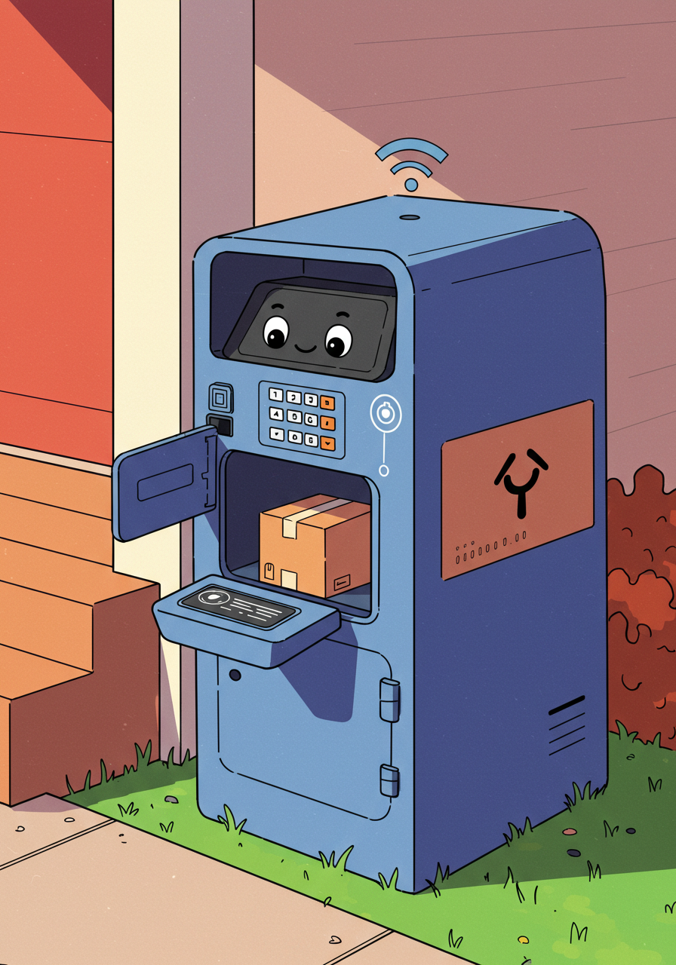



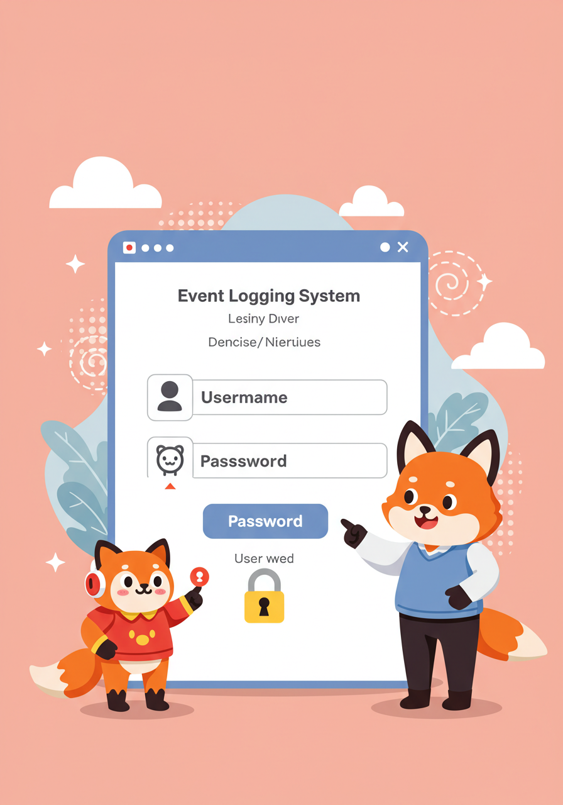
Project Deliverables
Functional prototype unit
Real-Time Alert System
Complete documentation including user manuals and testing reports
Image & Event Logging System
Presentation & demonstration

Slide 13
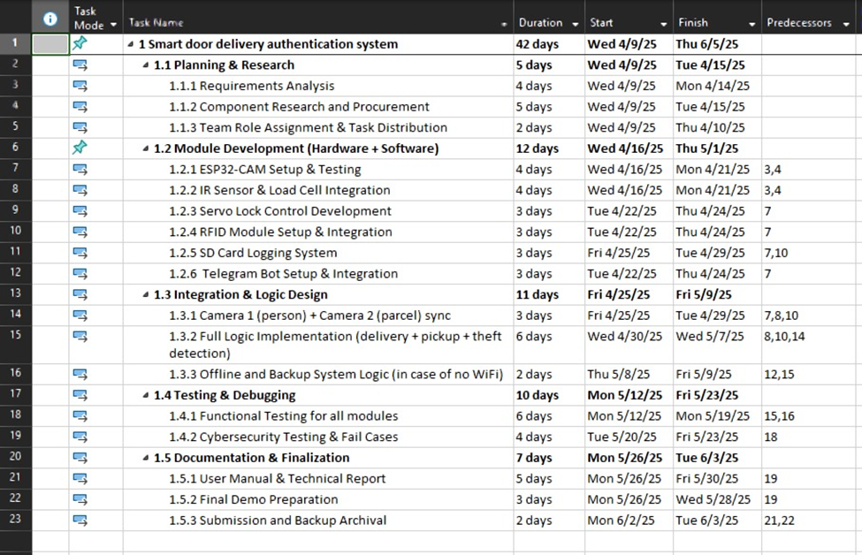
Scheduling and Milestones
Milestone 1
All research, procurement, and task distribution finalized.
Milestone 2
Hardware and software modules setup and tested
Milestone 3:
Cameras synced, full logic (delivery/pickup/theft) implemented, offline backup logic functional.
Milestone 4
Functional and cybersecurity testing conducted, system verified for reliability.
Final milestone
User manual, report, and demo completed; project submitted with backups

Slide 14

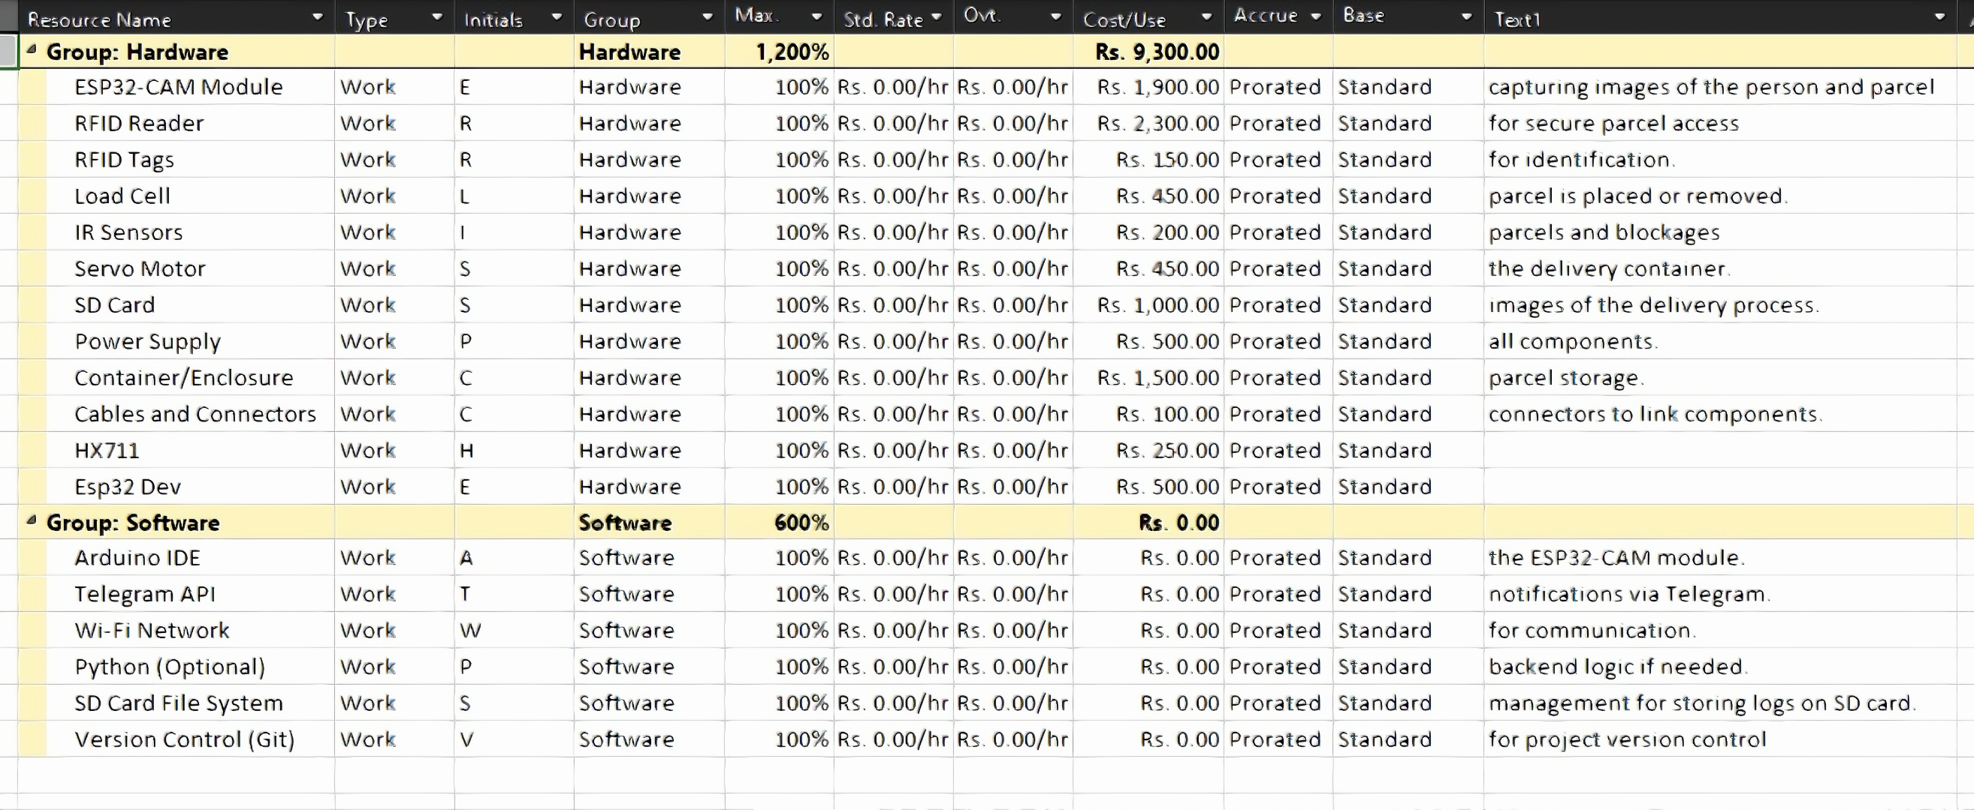
Budget plan
Software Components:
Used free tools like Arduino IDE and Telegram API to keep the project low-cost while ensuring key features.
Hardware Components:
The total estimated cost for hardware components are LKR.9300 (approx. 31 USD)
The budget focuses on essential hardware and free software, ensuring affordability without compromising functionality.

Slide 15

Thank you

